Slide 1
Machine Learning for Real Estate: Predicting House Prices
Tetiana, Samuel

Slide 2
AGENDA
Introduction
Data Exploration
Data Preprocessing
Model Building
Visualizing Results with Tableau
Conclusion
Next Steps

Slide 3
INTRODUCTION
Our objective is to develop a precise machine learning model for house price prediction using our dataset. We also aim to provide insights into features driving premium prices, especially those above $650K.
We'll cover data understanding, model building, and evaluation. Additionally, we'll use BI tools to reveal trends and factors influencing higher property values.

Slide 4
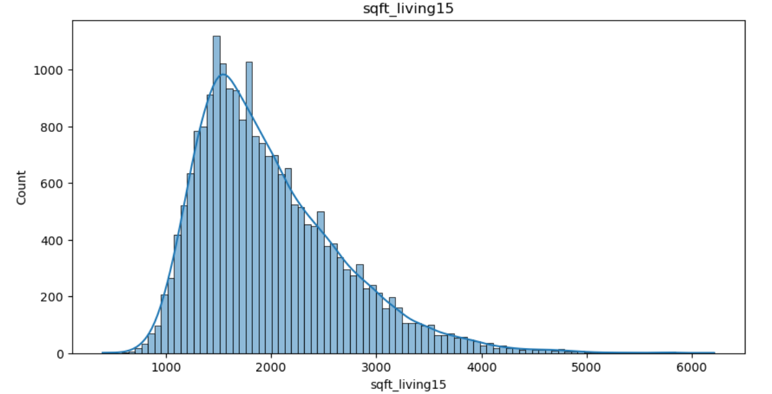
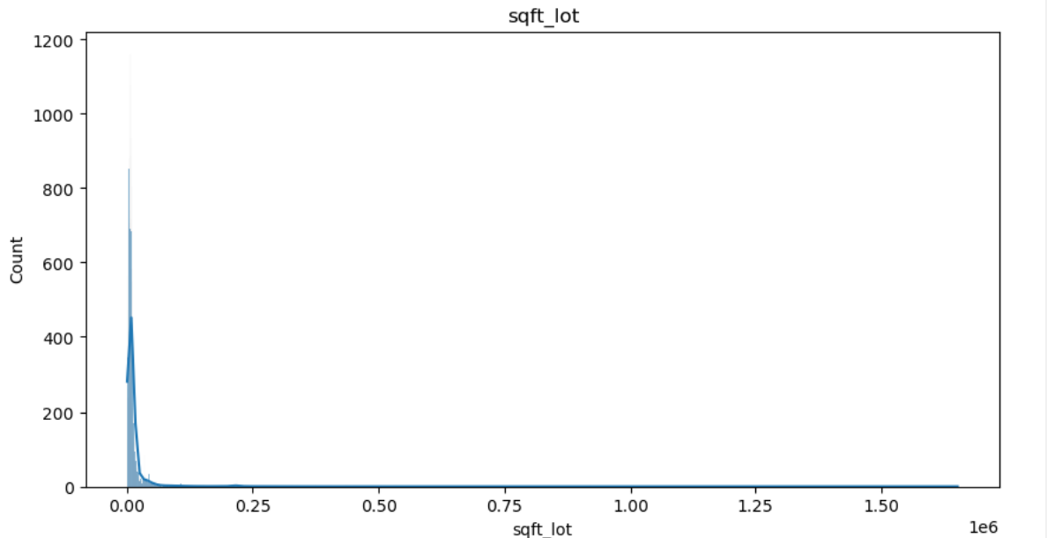
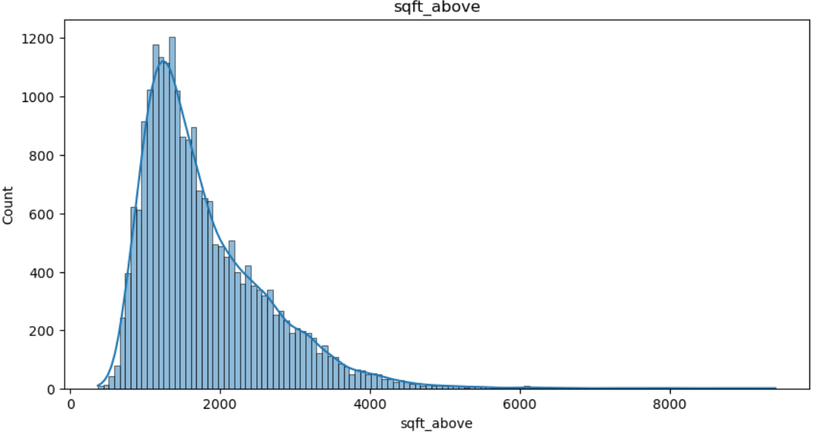
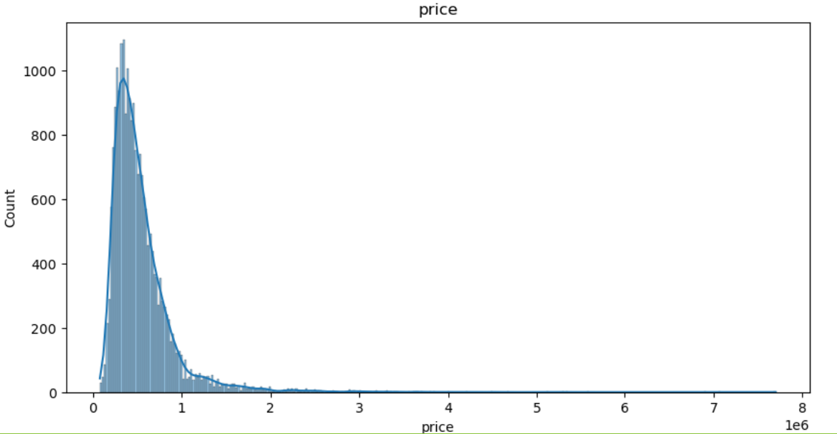
Data Exploration. Numerical

Slide 5
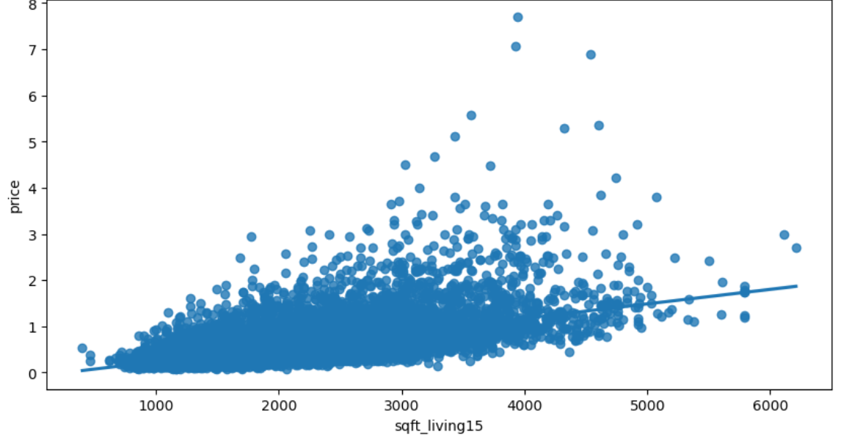
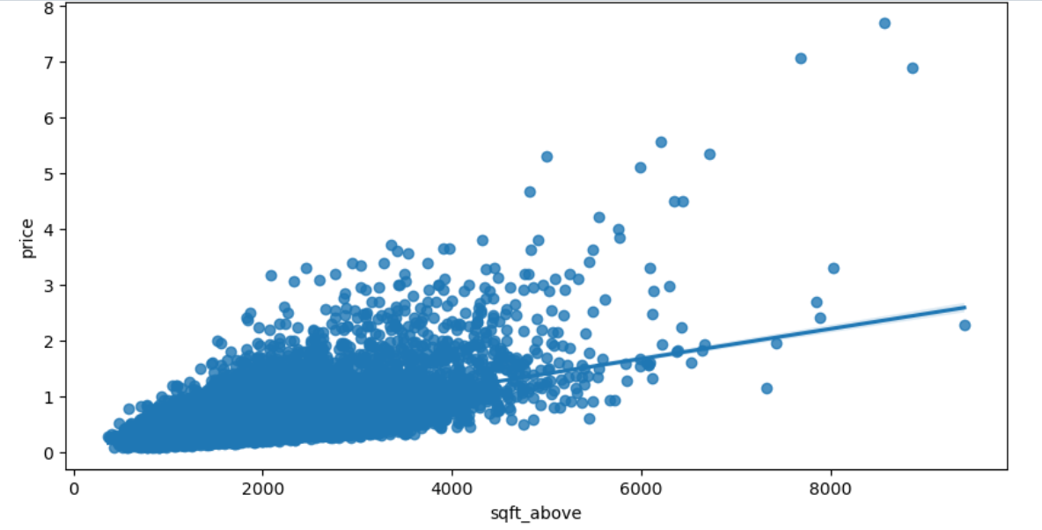
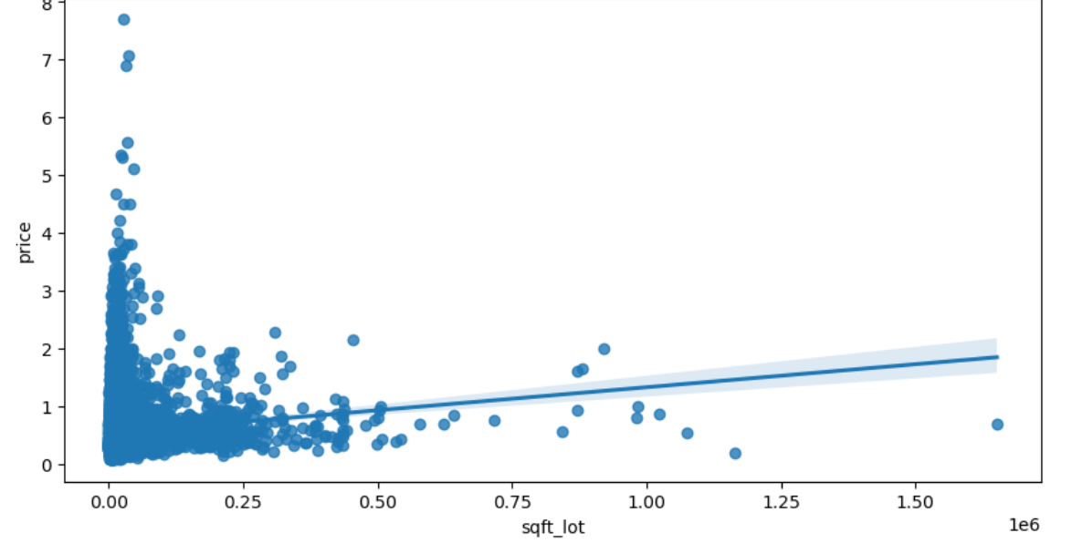
Data Exploration. Numerical

Slide 6
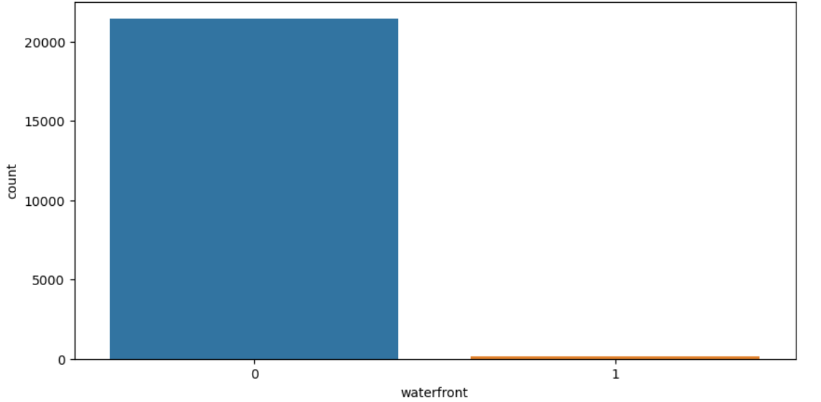
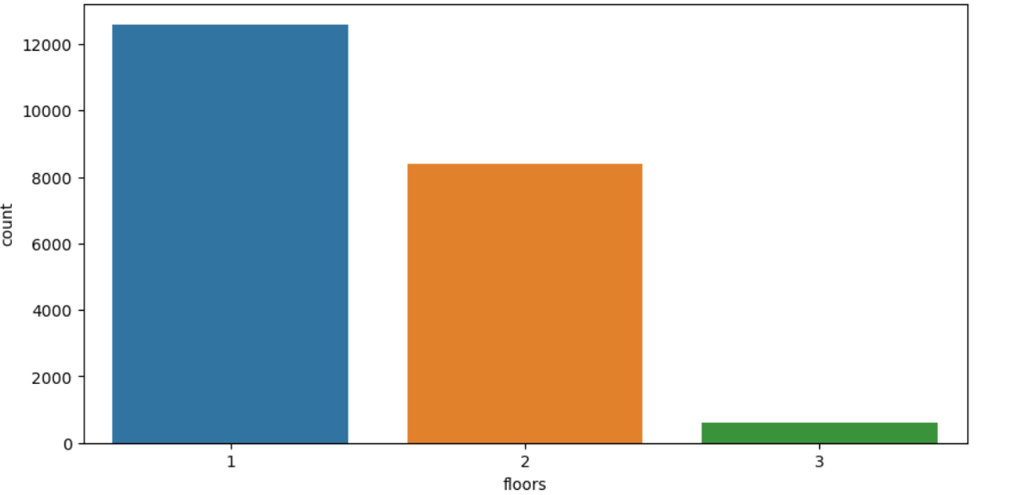
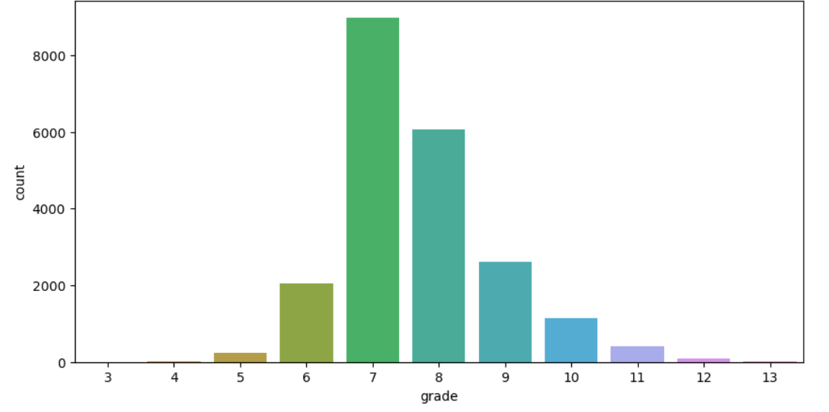
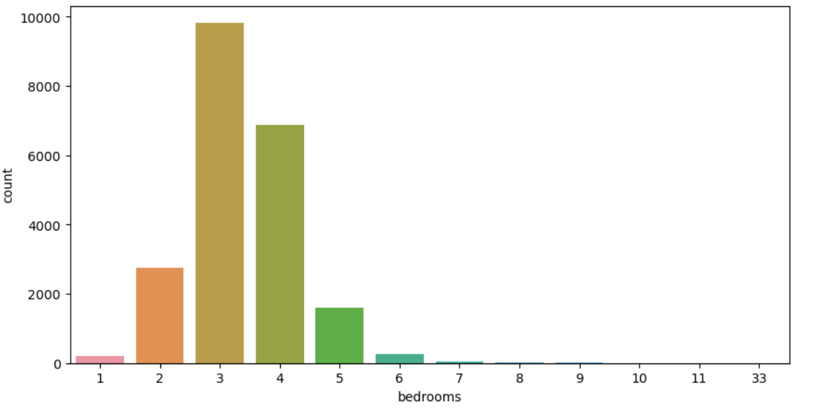
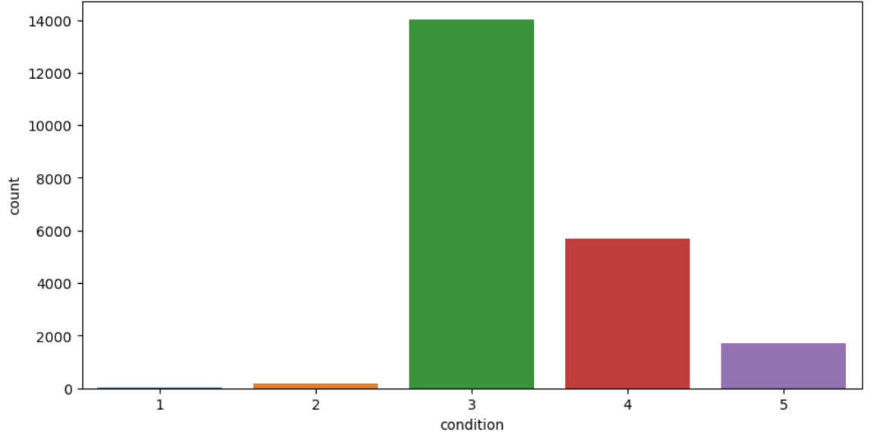
Data Exploration. Categorical

Slide 7
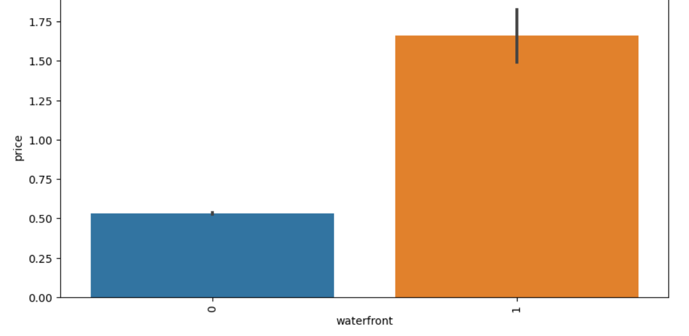
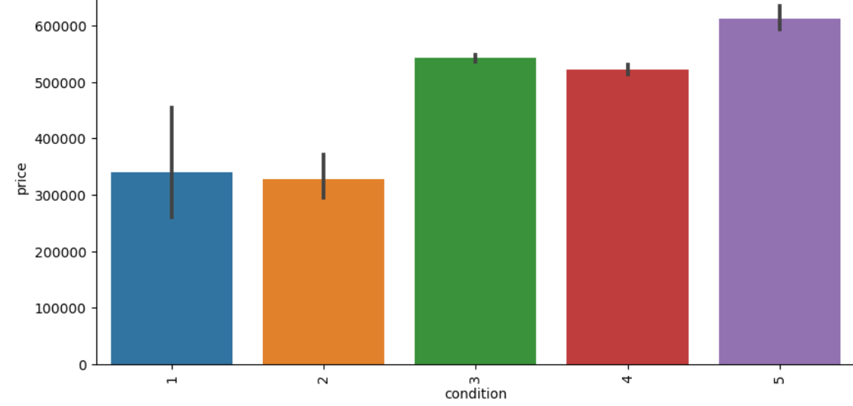
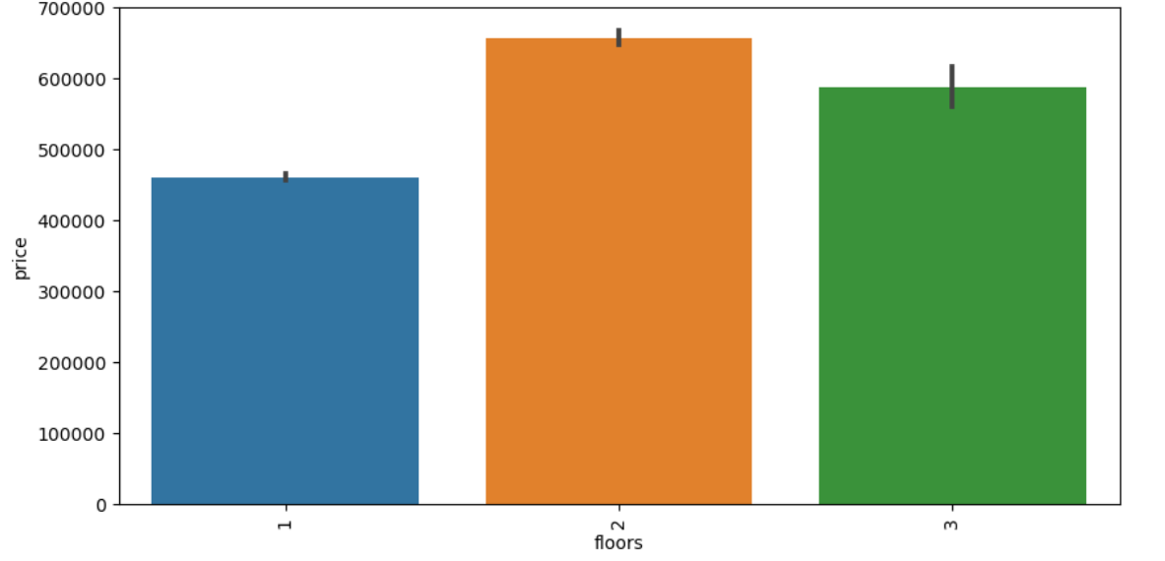
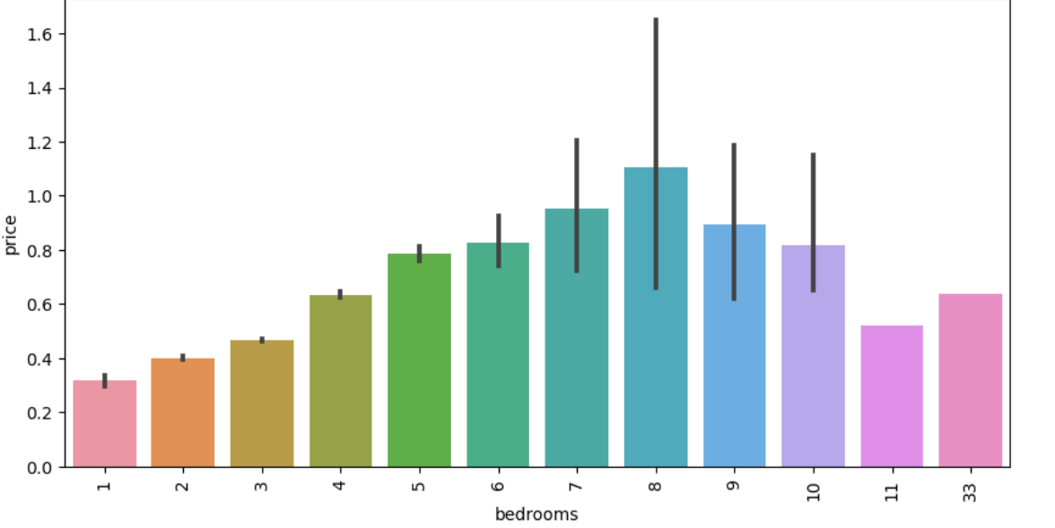
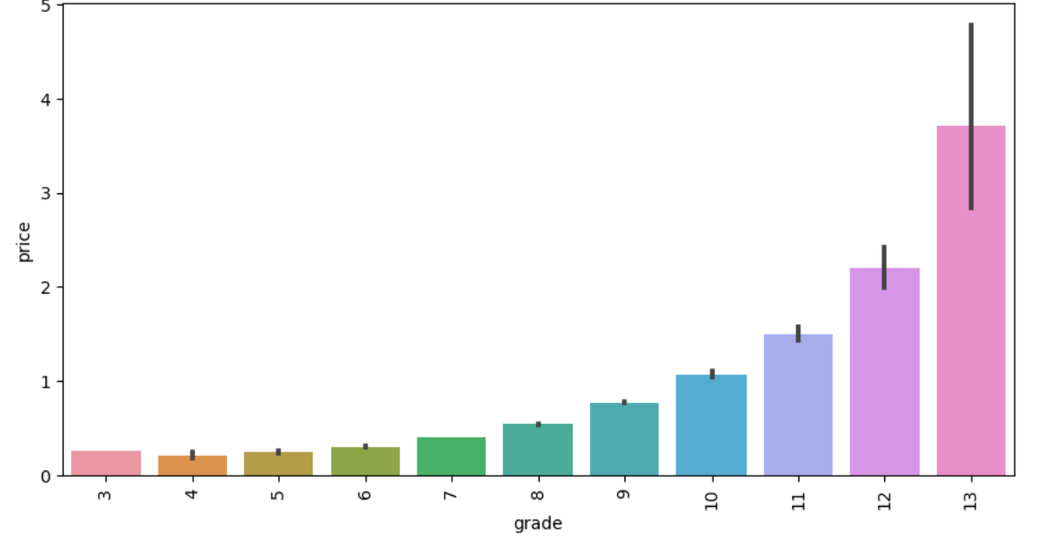
Data Exploration. Categorical/price

Slide 8
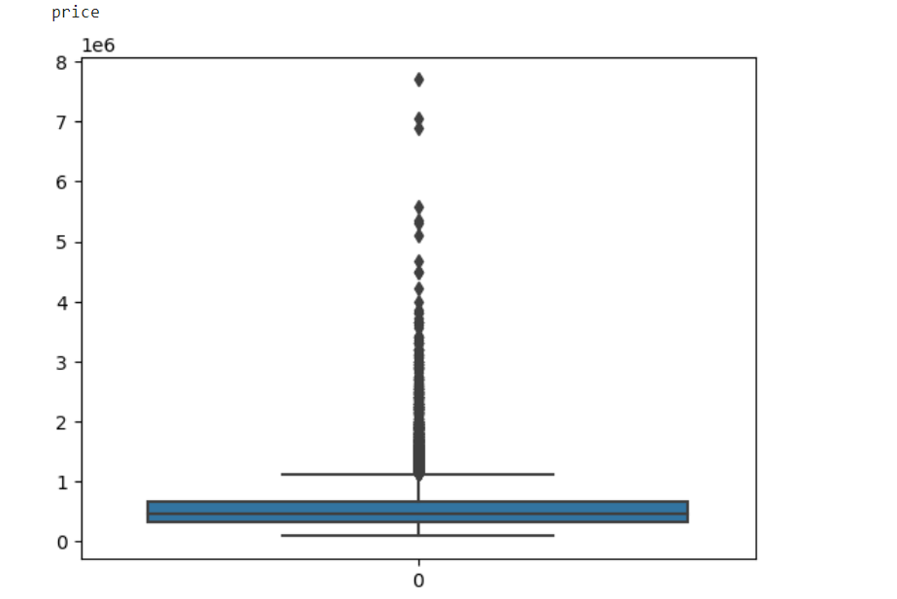
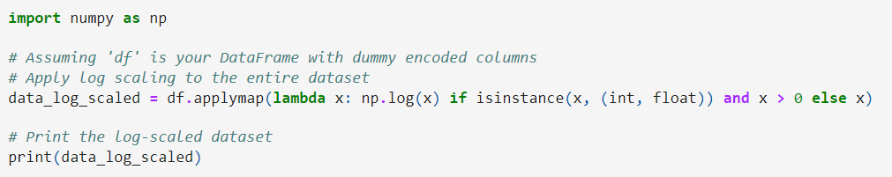
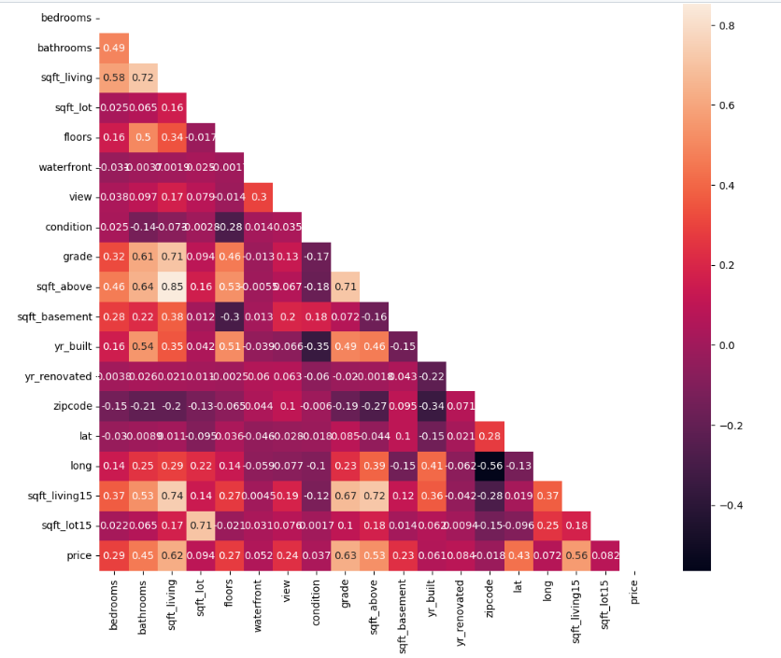
Data Preprocessing
To enhance the robustness of our analysis, we employed the Interquartile Range (IQR) method to identify and remove outliers. This process resulted in a dataset comprising 20,439 rows.
Recognizing the wide range of values in our variables, we applied scaling using the logarithmic scale. This approach helped normalize the data and mitigate the impact of extreme values, ensuring more stable and accurate model performance.
We identified strong positive correlation between price and grade, sqft_living, sqft_living15, sqft_above.
No evidence of multicollinearity among variables.

Slide 9
Model Building. Comparing models.
Let’s compare results from different models.
LinearRegression:
R2: 0.7162957997910053
MAE: 0.18163543380845448
RMSE: 0.23364930229496392
RandomForestRegressor (n_estimators=200):
Mean Squared Error: 0.02613551622618083
Mean Absolute Error: 0.11483442745543279
R-squared: 0.8641787036853722

Slide 10
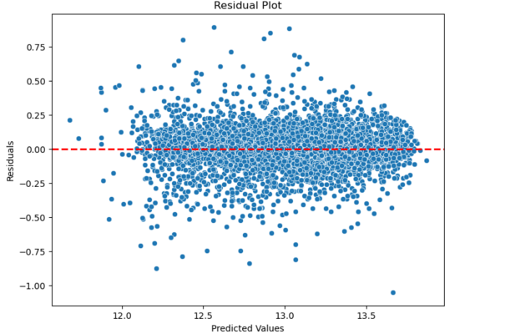
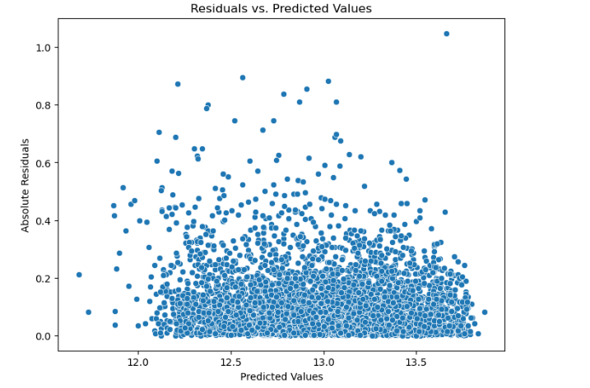
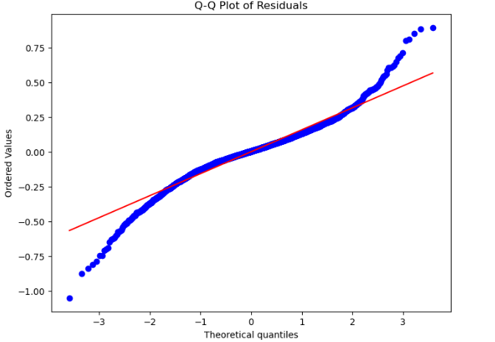
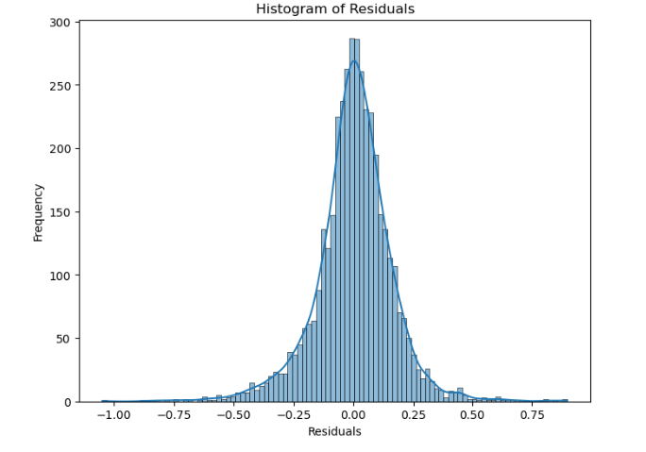
Model Building. Plotting final results

Slide 11
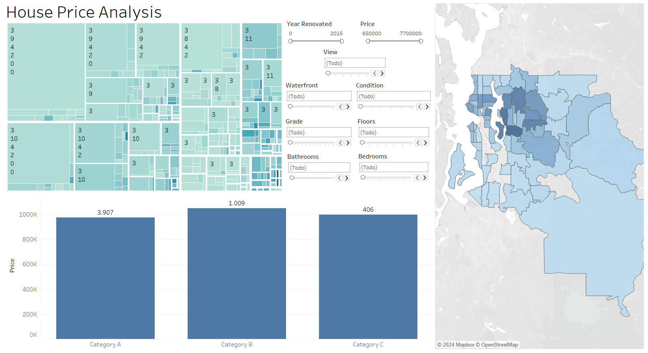
Visualizing Results with Tableau

Slide 12
Conclusion
Our Random Forest model demonstrates strong performance with low Mean Squared Error (0.0261) and Mean Absolute Error (0.1148), indicating accurate predictions of house prices.
The high R-squared value (0.8642) suggests our model captures 86.42% of the variance in house prices.
Residual plot analysis confirms the appropriateness of a linear model and the normal distribution of residuals, validating our model's reliability.
Overall, our Random Forest model is effective for predicting house prices, offering confidence for real-world applications in the real estate industry.
Key features impacting house prices include location, grade, year built, living room area, square footage above basement, bedroom, bathroom, condition, and number of floors. These features collectively shape the pricing dynamics in the housing market, providing valuable insights for stakeholders in the real estate industry.

Slide 13
Next Steps
Implement ongoing monitoring and refinement to adapt to changing market conditions and enhance model performance over time.
Model Optimization
Fine-tune our Random Forest model for improved accuracy by adjusting parameters and refining feature selection.
Data Expansion
Consider adding more relevant features or expanding the dataset timeframe to gain deeper insights into housing market dynamics.
Incorporate External Factors
Explore integrating external factors like economic indicators or market trends to enrich our model.
Rigorously validate the model on unseen data and deploy it for real-world applications in property valuation and market analysis.
Continuous Improvement
Validation and Deployment

Slide 14
THANK YOU

